Slide 1

SHRI RAMDEOBABA COLLAGE OF ENGINEERING AND MANAGEMENT,
NAGPUR
Department of Electronics Engineering
Semester: V-B
Session: 2022-23
Topic :- Vee Technologies Private Limited
Name : Prajwal Pandurang Shette
Roll No : B-12
Under the guidance of :-
Prof. Richa R Khandelwal
Ma`am

Slide 2

INTRODUCTION
Vee Technologies Pvt Ltd is part of The Sona Group, which was founded in 1920 in India.
serving as the platform by which Vee Technologies would later capitalize on a rich and expansive talent pool of resources to build a outsourcing enterprise.
Vee Technologies provides cutting-edge technology-enabled solutions customized to meet the unique requirements of our clients and are focused on helping them achieve their business goals in the most efficient and cost-effective way possible.
Headquartered in New York and Bangalore.

Slide 3

SERVICES
As a global leader offering solutions to businesses across various industry sectors.
Healthcare
Product Engineering
IT Services
Logistics
Media
Finance and Accounting Services

Slide 4
Image Processing Services
Customized image enhancement solutions
Space image processing solutions
Medical image processing solution
Character recognition solutions
Remote sensing solutions
Industrial solutions

Slide 5
Advancement of services
Vee Technologies uses multiple cutting-edge tools and techniques to deliver the best image processing solutions:
Feature extraction with pattern detection
Filtering of objects or removing background
Image comparison for change detection
3D visualization

Slide 6
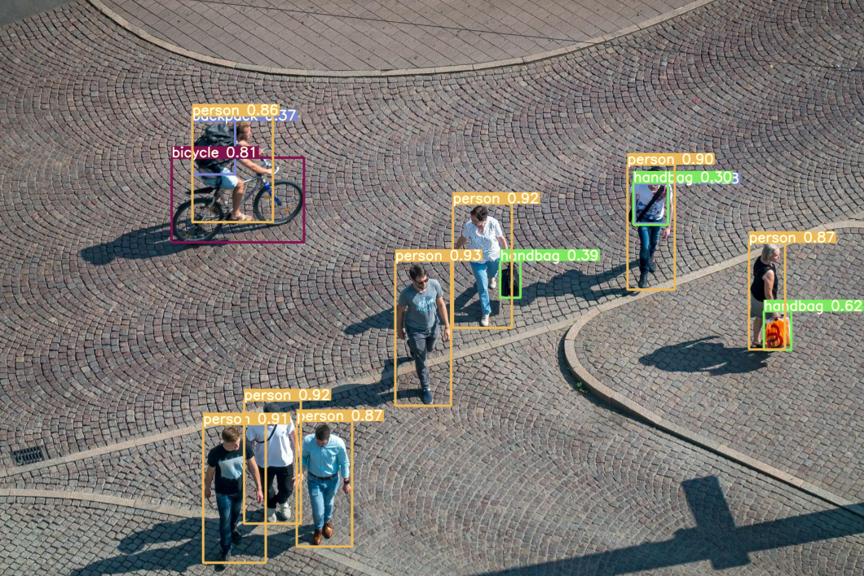
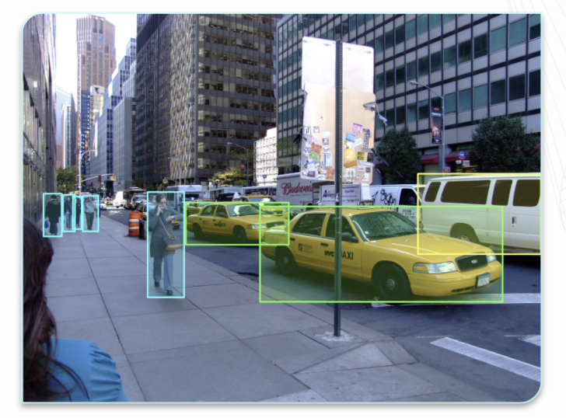
Image Annotation
Image annotation is defined as the task of labeling digital images.
The process of labeling images also helps machine learning engineers hone in on important factors in the image data that determine the overall precision and accuracy of their model.

Slide 7
Type of Image Annotation
Annotation Shapes
Image Classification
Object Detection and Object Recognition
Image Segmentation
Boundary Recognition
Boundary Boxes
Polygons
Landmarking
Line and Splines

Slide 8
Intelligent Image Annotation Services
Image annotation and tagging
Object recognition and image classification services
Bounding box image annotation
Pixel level semantic segmentation
Line and splines annotation
Point and dot annotation
Cuboid annotation
Poly mask annotation

Slide 9

How to Join Vee Technologies ?
Carreers – Vee Technologies
(https://www.veetechnologies.com/careers.htm)
Vee Technologies Jobs - Naukri.com
(https://www.naukri.com/veetechnologies-jobs-careers-35346)
Vee Technologies Jobs – Shine .com
(https://www.shine.com/job-search/fresher-hiring-jobs-in-vee-technologies)
Vee Technologies – Linkedin
(https://in.linkedin.com/company/vee-technologies)

Slide 10
Required Skill Set
Good understanding of Computer vision and Image Processing concepts.
Experience in training CNN for segmentation, classification and Object Detection.
Experience in handling image and video data is must.
Experience using opensource libraries like OpenCV and/or Scikit-Image is must.
Experience in using either of the Deep Learning frame work like Tensorflow .
Excellent debugging and analytical skills. Expert in Python programming.
Experience scripting in Linux Environment.
Experience in Machine Learning.

Slide 11
References
https://www.veetechnologies.com/
https://viso.ai/computer-vision/image-annotation/
https://in.linkedin.com/company/vee-technologies

Slide 12
Thank You

